Slide 1


Patient and Public Involvement and Engagement (PPIE) in trial methodology research: Process, experiences, and recommendations from the SPIRIT- and CONSORT-Surrogate project
Dr Anthony Manyara
@AnthonyManyara_ @Consort_surr

Slide 2

YouTube educational video on surrogate outcomes
https://youtu.be/6upTJHdRHpg?si=pjm-J1R6PgQlvkgI

Slide 3
Surrogate outcomes – definition
An outcome that is used in trials as a substitute for a target outcome (severe morbidity, mortality, health related quality of life)​
Surrogate outcomes
A biomarker or intermediate outcome that is intended to substitute and predict for a target outcome.
Target outcome
Direct measure of how individual feels, function or survive.
Cardiovascular Mortality
e.g., LDL-cholesterol
Cardiovascular Mortality
e.g., Exercise capacity

Slide 4
Need for reporting guidelines
While surrogate outcomes improve trial efficiency, they have limitations
  May not predict the intervention effect on target outcome
  Overestimation of intervention effects
  Limited information on intervention harms
Need for reporting guidelines – improve transparency and completeness in reporting
  SPIRIT-Surrogate
  CONSORT-Surrogate

Slide 5
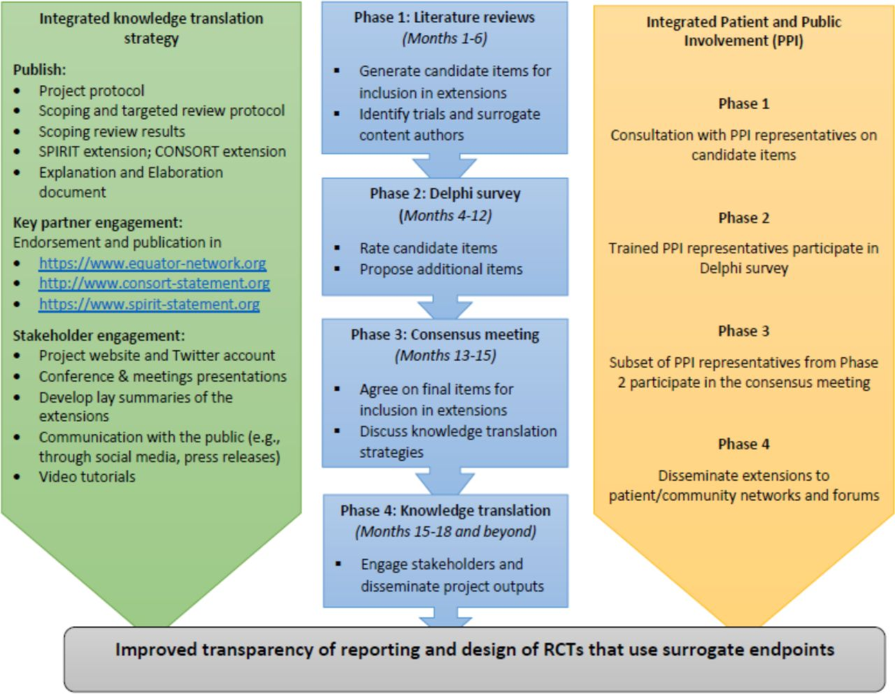
Development of SPIRIT-and CONSORT-Surrogate

Slide 6
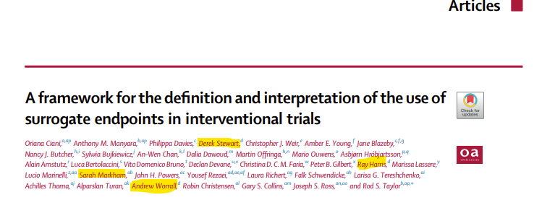
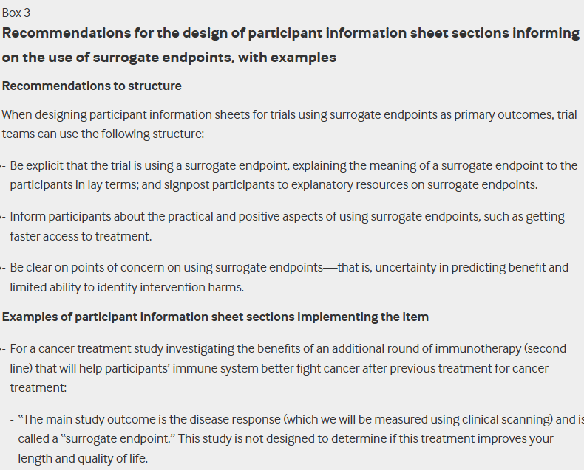
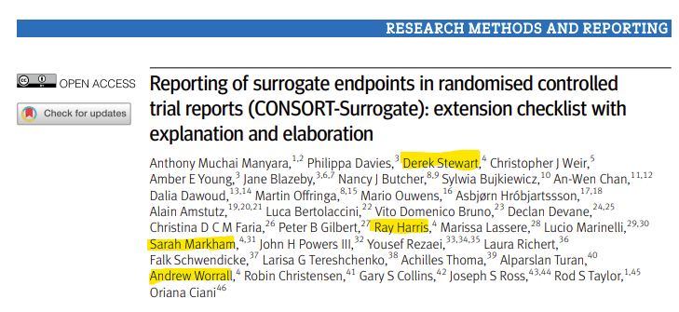
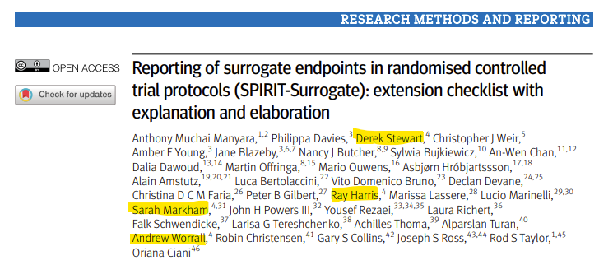
Final publications
EclinicalMedicine
BMJ

Slide 7
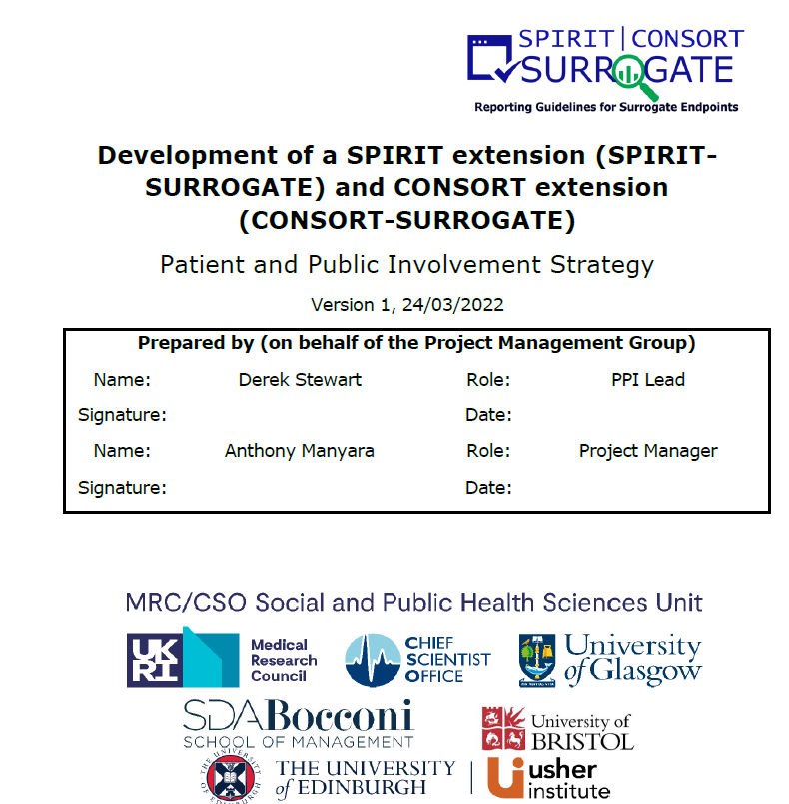
Process of PPIE in project
Derek Stewart part of grant co-applicants, as PPIE partner
Involvement strategy drafted
Three other PPIE partners joined as part of project to completion
  Sarah Markham
  Andrew Worrall
  Ray Harris
Feedback survey to document experiences

Slide 8
Learning workshop prior to Delphi survey
Aim: to support meaningful participation in Delphi survey
2-hour virtual workshop on the 19th August 2022
Attended by 19 PPIE partners (18 from UK, 1 from Canada)
Majority (87%) of the 19 participated in the e-Delphi survey

Slide 9
What worked well
Learning workshop
    Engaging and interactive
    Opportunity to learn from lived experiences of other PPIE partners.
    Reading resources after workshop
Supports during Delphi survey participation
    Glossary of terminology
    Help text on items being rated.
    Clear instructions on how to rate items
Financial compensation

Slide 10
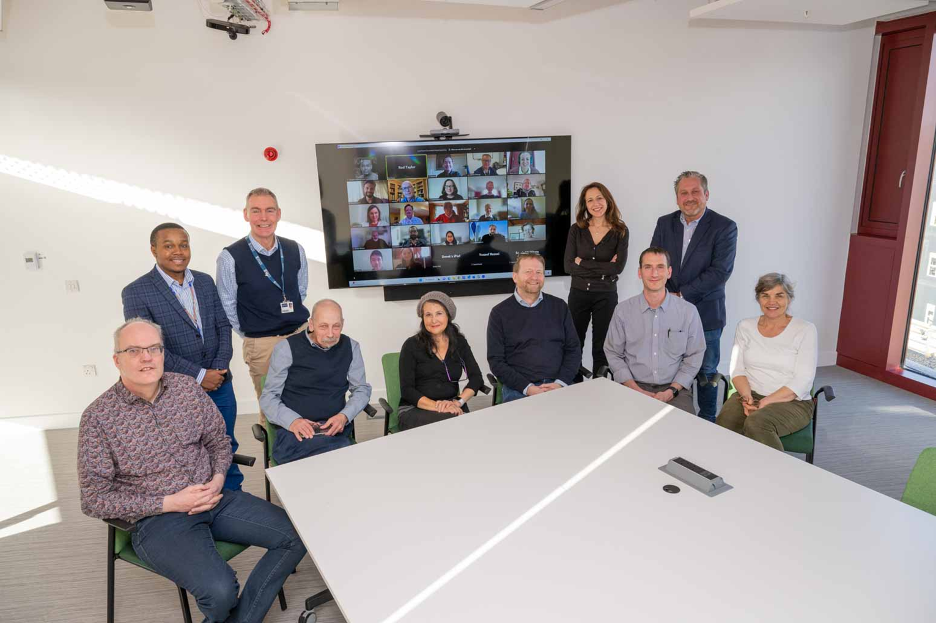
Consensus meeting
Hybrid meeting on 13-14th March 2023: 33 delegates
4 PPIE partners attended: 1 physically 3 virtually
Partners contributed first

Slide 11
PPIE in the Consensus meeting
Presented the patient perspective
Reminded delegates of why the project was important
Clarification of issues
Corrected some grammar
Suggested strategies to disseminate and implement the extensions
Created humour

Slide 12
Knowledge translation
Co-authorship
YouTube educational video
Involvement in webinars presenting the patient perspective

Slide 13
Recommendations for trial methodology projects
Involve early – grant application stage
Involve with a plan and layered approach – strategy to guide PPIE
Involve meaningfully in a genuine way – avoid tokenism
Involve with support and in safe spaces – safe spaces to learn and engage
Involve with evaluation, reflection, and feedback – what went well and what could be improved
Involve with a budget – compensation and other costs

Slide 14
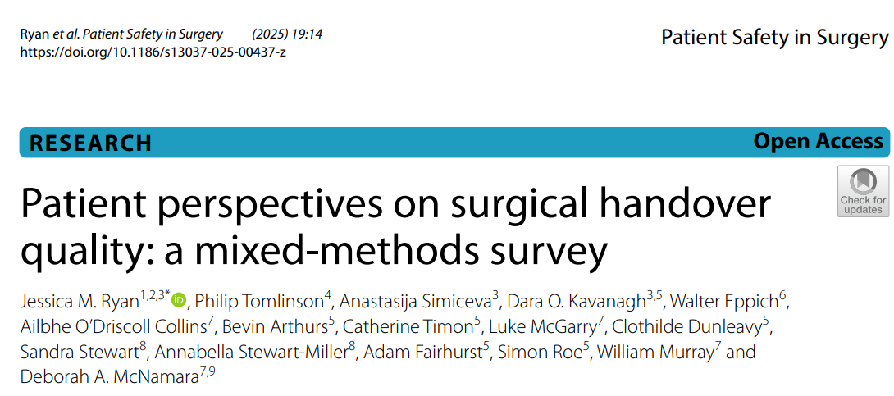
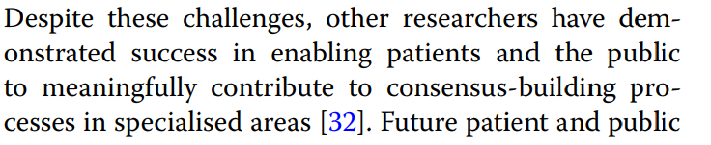
32. CONSORT-Surrogate extension

Slide 15


Acknowledgements
Medical Research Council
Executive Committee
Project Management Group
Joseph Ross​ (Chair)
Martin Offringa​
Nancy Butcher​
An-Wen Chan​
Gary Collins​
Sylwia Bujkiewicz​
Dalia Dawoud​
Mario Ouwens​
Anthony Manyara​ (RA)
Oriana Ciani​ (PI)
Rod Taylor​ (PI)
Jane Blazeby​ [Amber Young] (Co-I)
Derek Stewart​ (PPI Lead, Co-I)
Philippa Davies​ (Co-I)
Chris Weir (Co-I)
PPIE advisory group
Sarah Markham
Andrew Worrall
Ray Harris

Slide 16

Thank you
Anthony.Manyara@bristol.ac.uk

