Slide 1



Health systems data for trial outcomes: thinking about data utility
TMRP Outcomes Working Group
Rob Trubey
Centre for Trials Research, Cardiff University

Slide 2
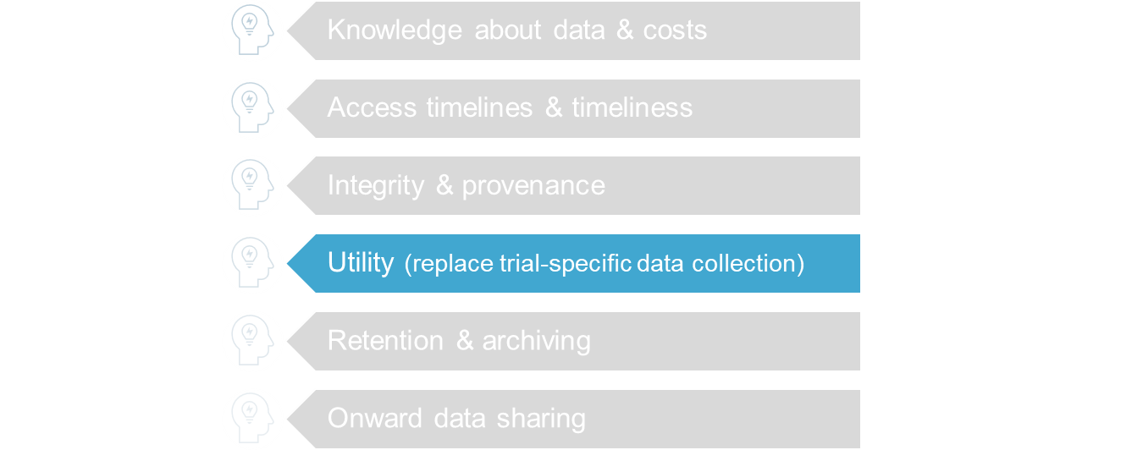
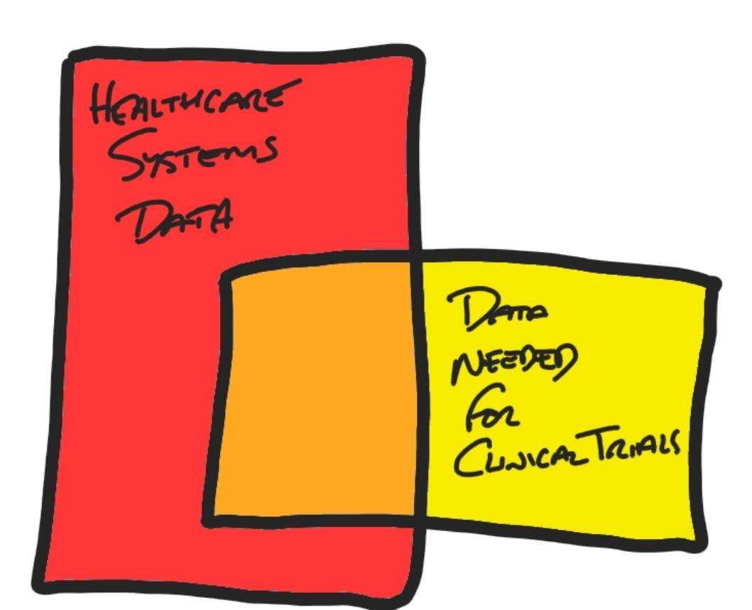
Using HSD for trial outcomes
via Matt Sydes

Slide 3
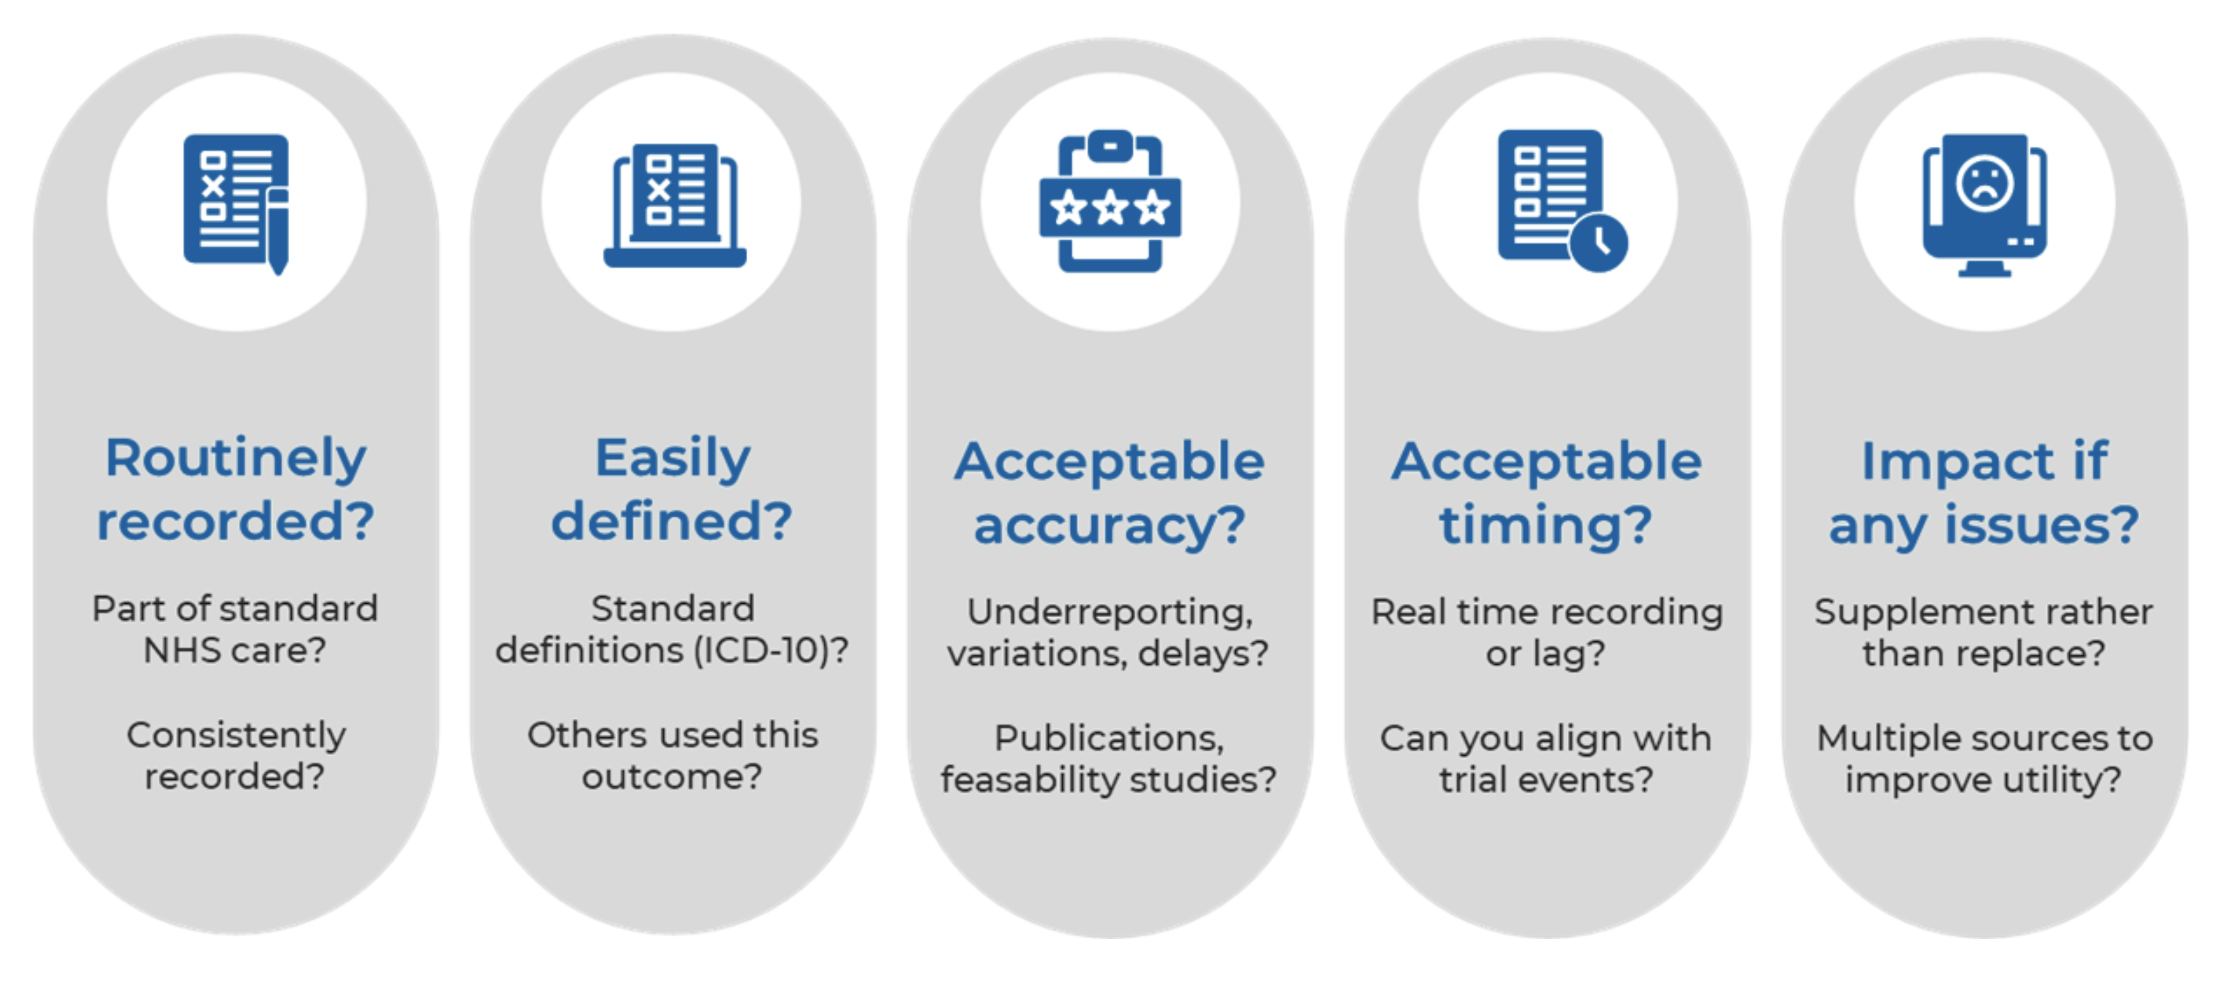
The big questions

Slide 4
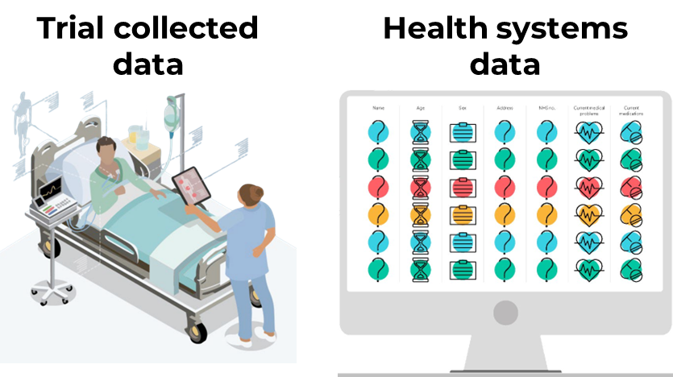


What are DUCkS?
Patient-level comparisons
Trial-level comparisons

Slide 5
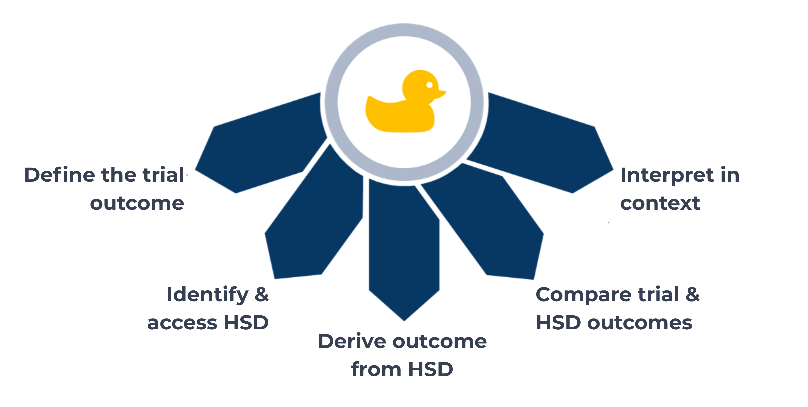
Conducting DUCkS

Slide 6
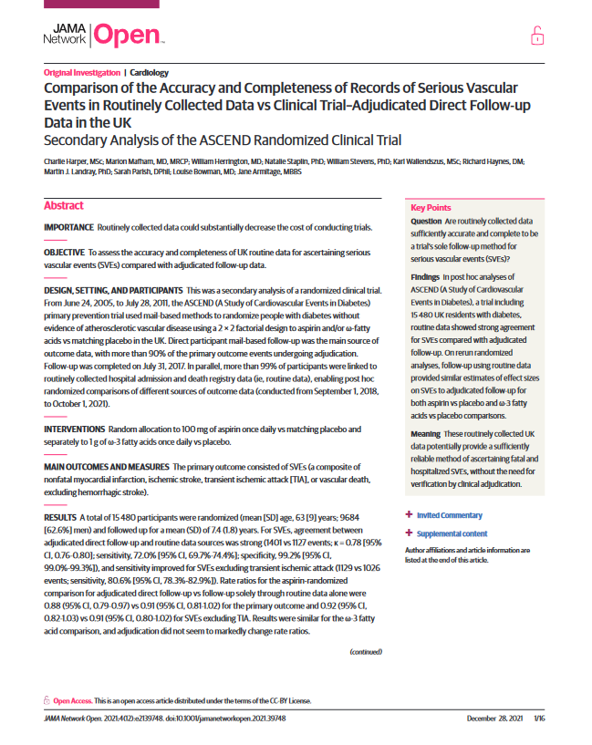
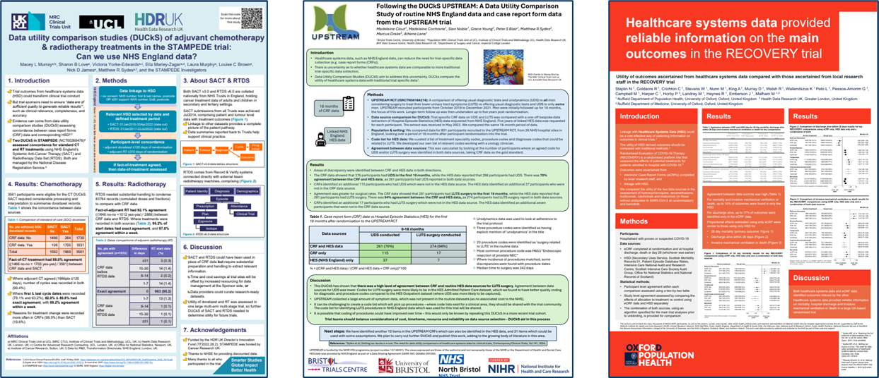
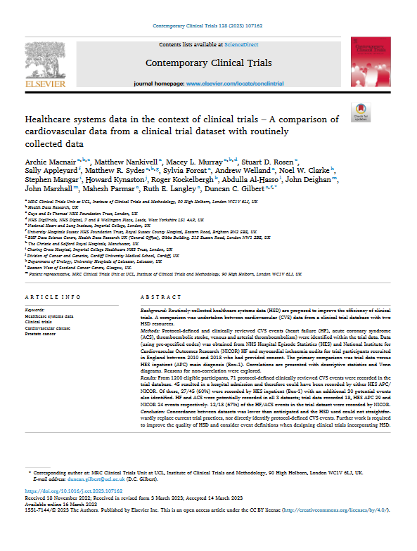
DUCkS: a growing area

Slide 7
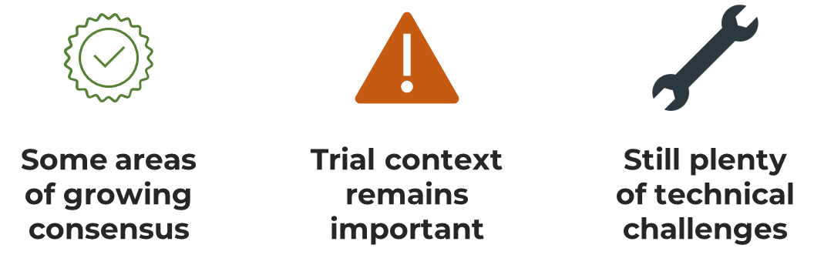
What do we know so far?

Slide 8
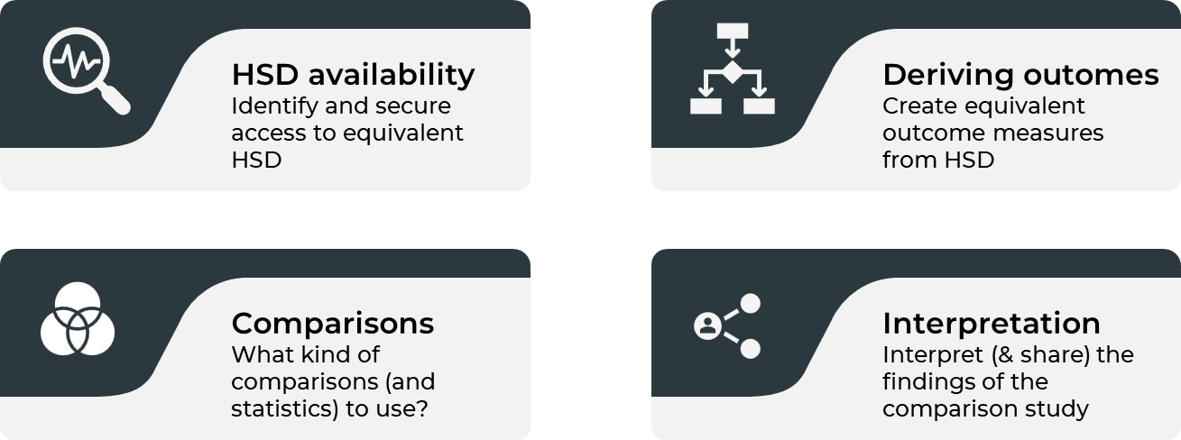
International perspectives
Notes:
context

Slide 9
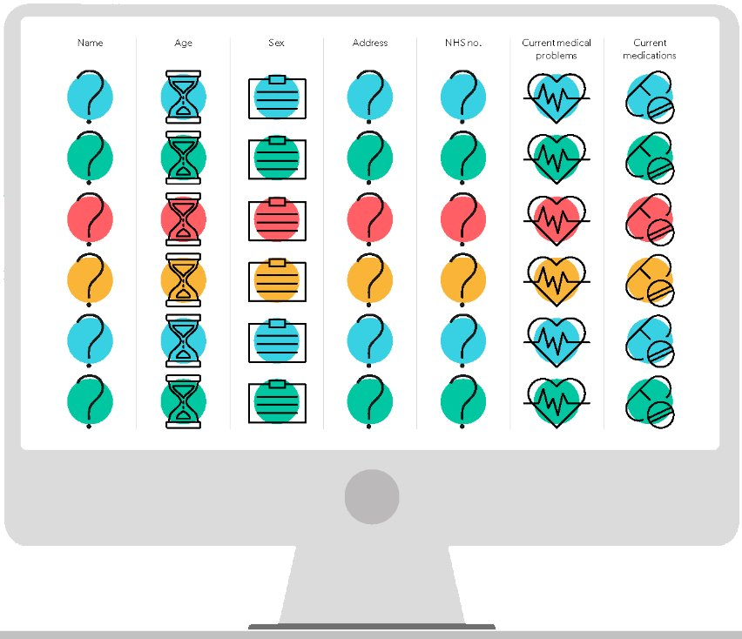
Public perspectives
Baseline distrust of medical records
DUCkS seen as a positive way to build trust
01
02
03
Concerns about equity and completeness

Slide 10
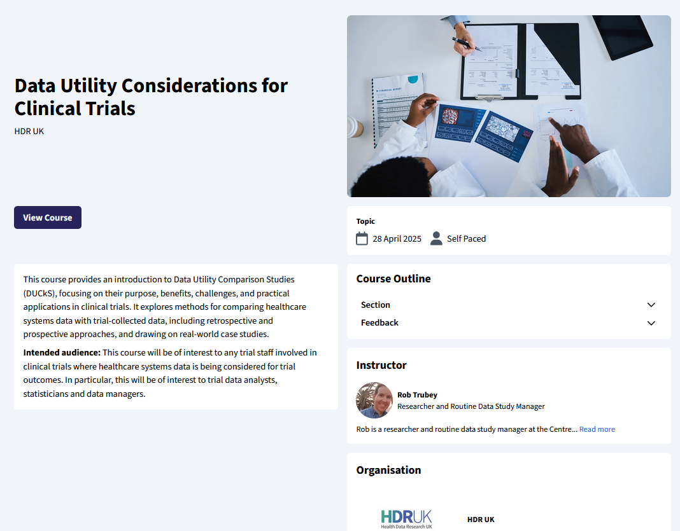
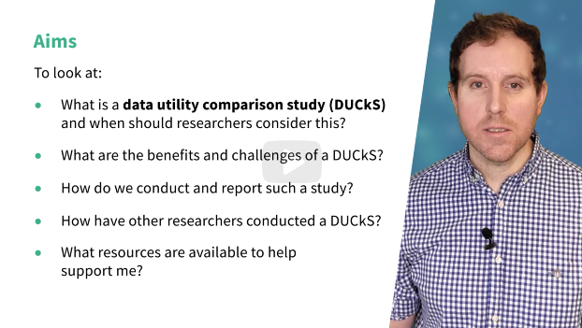
Free DUCkS training
Data Utility Considerations for Clinical Trials
https://hdruklearn.org/courses

Slide 11
Thanks
Thanks for listening!
Always happy to answer questions:
trubeyj@cardiff.ac.uk

